Slide 1
SDN Basics and Open Flow
Bansari Patel
CS374 –MODERN NETWORKS
DECEMBER 2021– JULY 2022
Teaching cum. Research Assistant
Computer Science and Engineering
03-01-2022

Slide 2
Chapter Objectives
SDN architecture
SDN data plane
SDN data plane network device
OpenFlow logical network device
OpenFlow environment
OpenFlow switch
OpenFlow versions

Slide 3
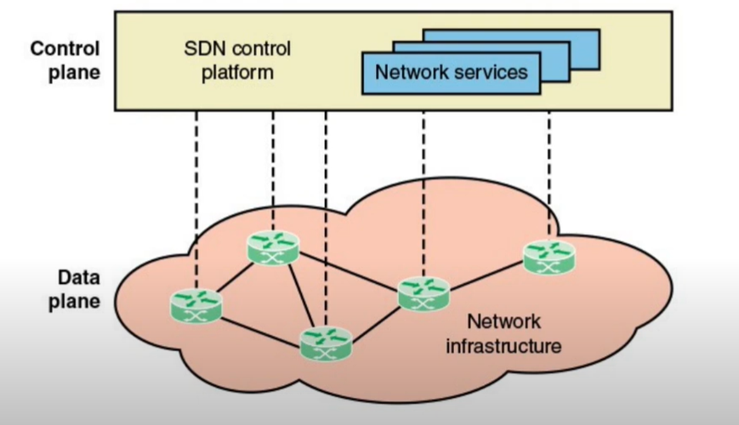
Control and Data Plane

Slide 4
SDN
Traditional network is very inflexible
It is requires all the network devices to implement the same protocol for communication
However in SDN the central controller performs complex functionalities like routing, naming, policies and security.
Separation of data and control plane
Control plane is implemented in controller
SDN controller has a centralized view of the network
Open interfaces are defined between the devices
The network is programmable by applications
SDN provides flexibility, customization, scalability for cloud computing, edge computing, fog computing, mobility, social networking, video streaming, augmented reality, virtual reality, vehicular area network….

Slide 5
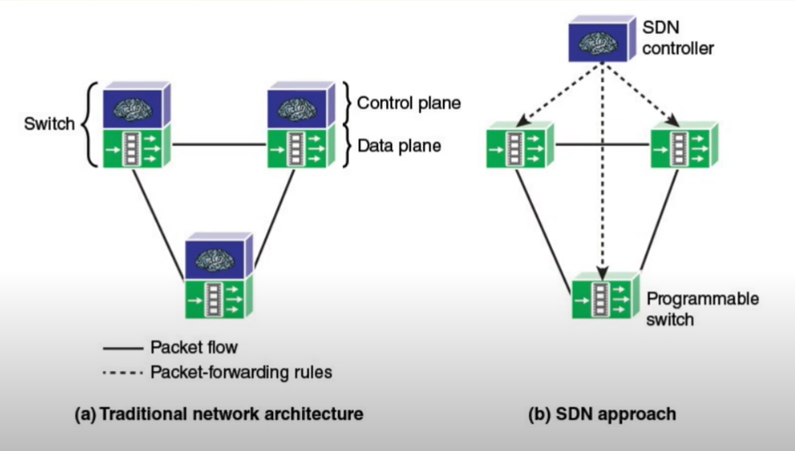
Control and Data Plane

Slide 6
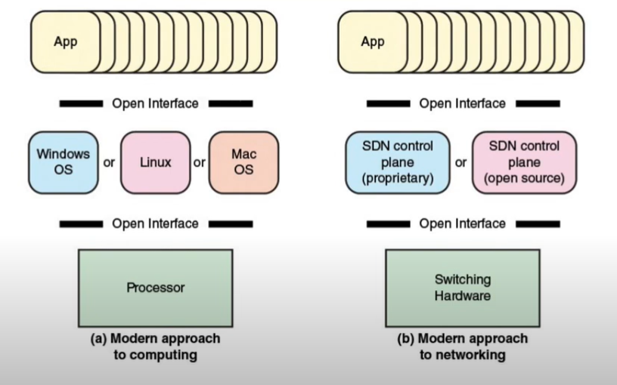
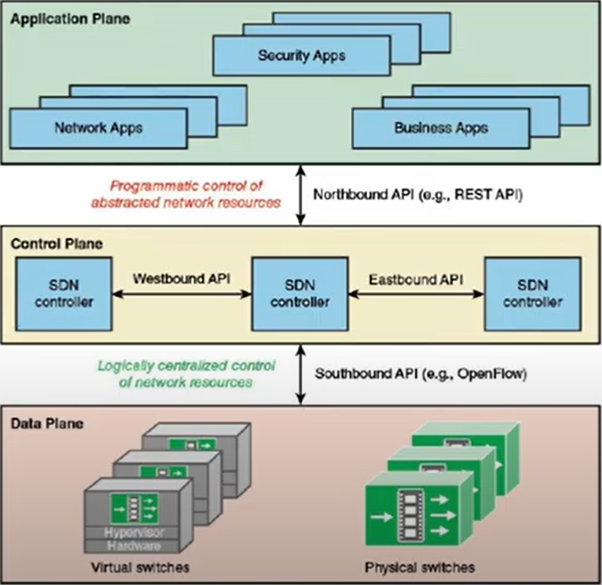
SDN Architecture

Slide 7
Standards-Developing Organizations
Internet Society – (Organization)
IETF – Internet Engineering Task Force - Working on protocols for end systems (Routing)
IRTF – Internet Research Task Force – Provides useful information to APIs
ITU-T – International Telecommunication Union - (Organization)
SG 11 – Study Group – Studying the framework for SDN signaling (Requirements, protocols and specifications)
SG 13 – Working for Future Networks (Cloud Computing, Mobile computing, Edge computing, Next generation Networking)
SG 15 – Working on Openness – Transportation aspect of SDN
SG 16 – Working on Multimedia communication (Opnflow)
ETSI – European Telecommunications Standard Institute - (Organization)
NFV ISG – Defines the standards for NFV

Slide 8

Industry Consortia
ONF (Openflow)
ODCA (Working on interoperability solutions and provides the services for cloud computing)
Atis (Alliance for Telecommunication Industry) – Provides the tools for telecommunication services.

Slide 9
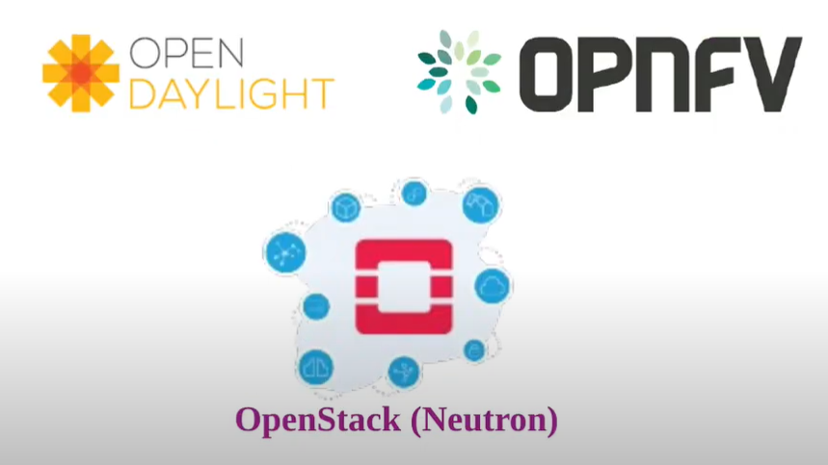
Open Development Initiatives
Open Daylight – Main focus is on Linux – Provide resources to develop sdn controller
OpenFV – Focus is on NFV
Openstack – Working on Cloud OS – (Neutron service is working on SDN)

Slide 10
SDN data plane
Resource Layer
Infrastructure Layer
Network forwarding devices perform the transport and processing of data
Data plane network elements/switches
According to decisions made by the SDN control plane.
These devices perform a simple forwarding function

Slide 11
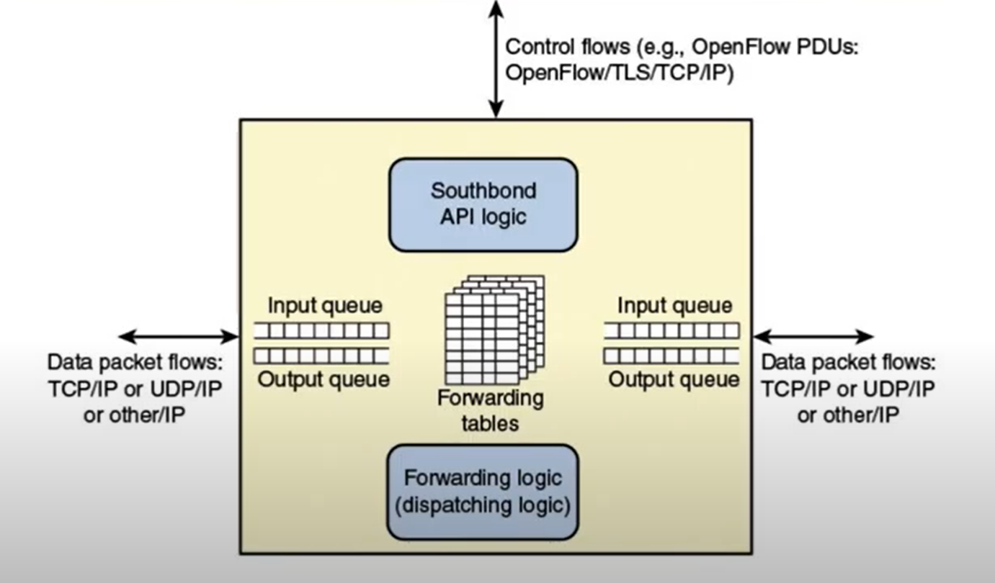
SDN Data Plane Network Device

Slide 12
SDN Data Plane Network Device - Functions
Control Support Function
Interacts with the SDN control layer.
Data forwarding function
Accepts incoming data flows from other network devices and end systems and forwards them resource layer. (Based on rules)

Slide 13
OpenFlow Logical Network Device
To implement SDN, two requirements must be met.
A common logical architecture in all switches, routers, and other network devices.
Managed by an SDN controller.
A standard, secure protocol is needed between the SDN controller and the network device.
These requirements are addressed by OpenFlow.

Slide 14
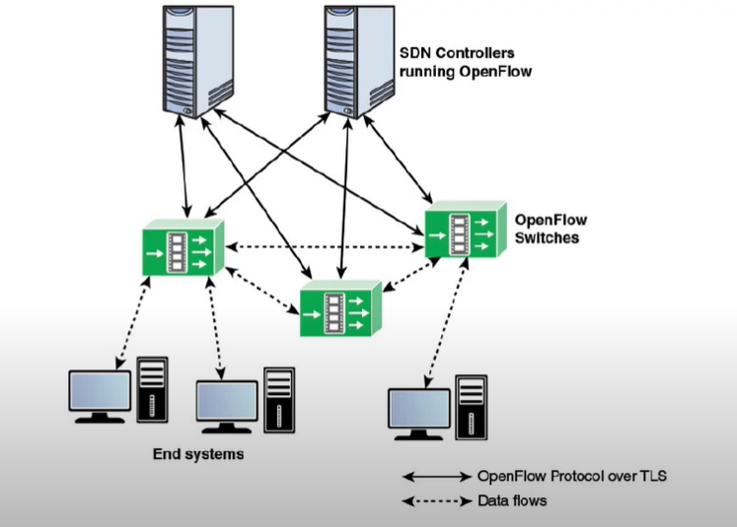
OpenFlow Environment – OpenFlow switch context

Slide 15
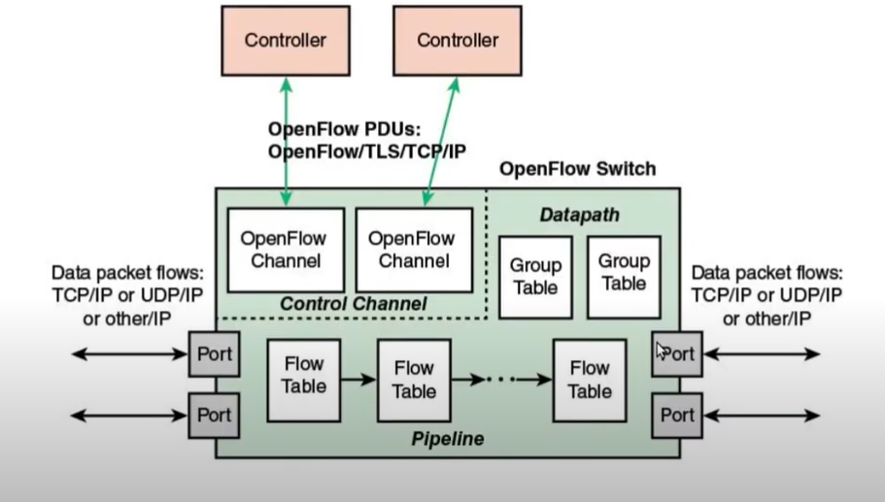
OpenFlow Switch

Slide 16
OpenFlow Ports
Physical Ports : For Hardware interfaces – eg. Ethernet Interfaces
Logical Ports: Do not link to a hardware interfaces, higher level abstraction
Reserved Ports: Specify generic forwarding actions like sending to controller, flooding, forwarding using OpenFlow methods.

Slide 17
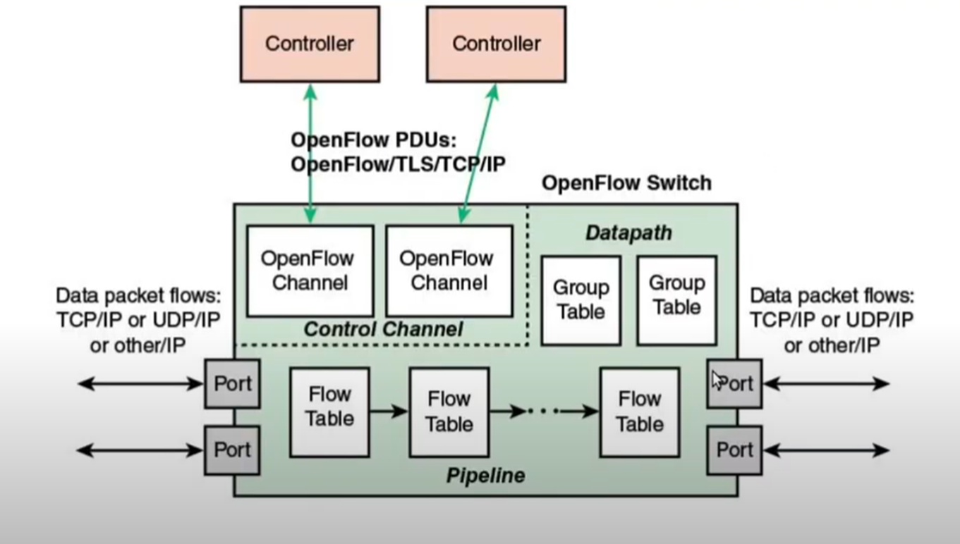
OpenFlow Switch
OpenFlow channel
OpenFlow port
Flow table
Group table
Meter table

Slide 18
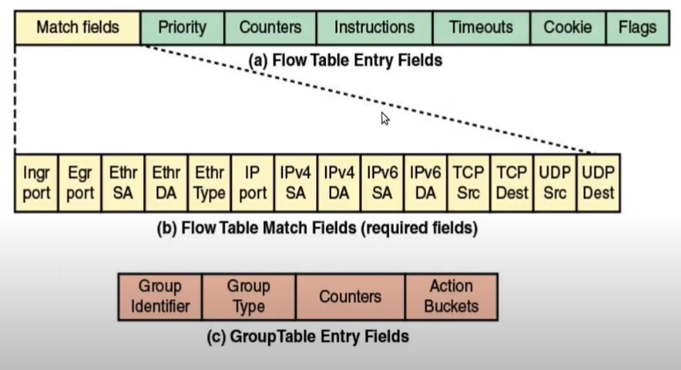
OpenFlow Switch – Flow table structure

Slide 19
Flow Table
A flow table consist of flow entries. The main components of a flow entry are as below:
Match fields : is used to match against packets. Consist of ingress port, packet header and optionally, metadata specified by previous table
Priority : Matching precedence of the flow entry
Counters: Updated when packets are matched
Instructions : to modify the action set
Timeouts : Maximum amount of time or idle time before flow is expired by switch
Cookie : May used by controller to filter flow entries affected by flow statistics, flow modification and flow deletion request. Not used when processing packets.
Flags : flags alter the way flow entries are managed

Slide 20
OpenFlow Switch – Flow table pipeline
If there is more than one flow table, they are organized as a pipeline
Provide the SDN controller with flexibility
Two stages of processing
Ingress processing
Egress processing

Slide 21
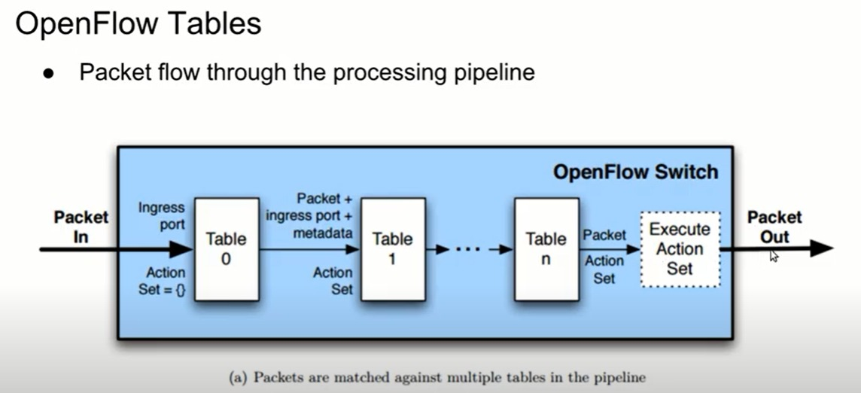

Slide 22
Pipeline Processing
Packet processing starts at flow table 0
Packet is matched against the flow entries of the flow table
If a flow entry is found, the instruction set in that flow entry will execute
“GoTo Table Instruction” to direct the packet to another flow table
Pipeline can only go forward not backward
Table miss: when packet does not match a flow entry in a flow table
Table-miss packets can be dropped, pass them to another table or sending them to a controller
If there is not table-miss flow entry, the packet is dropped

Slide 23
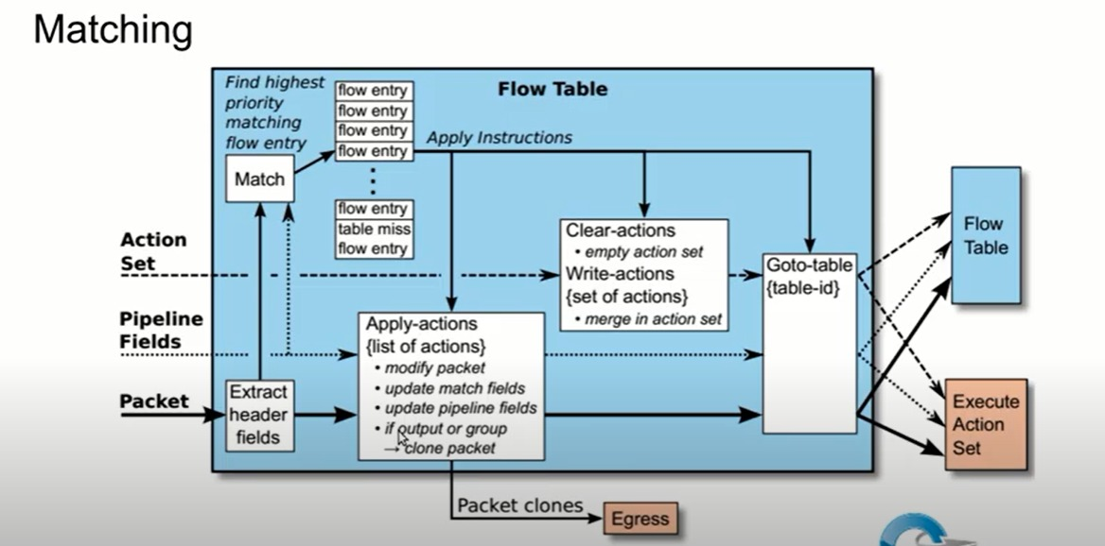
Matching Process

Slide 24
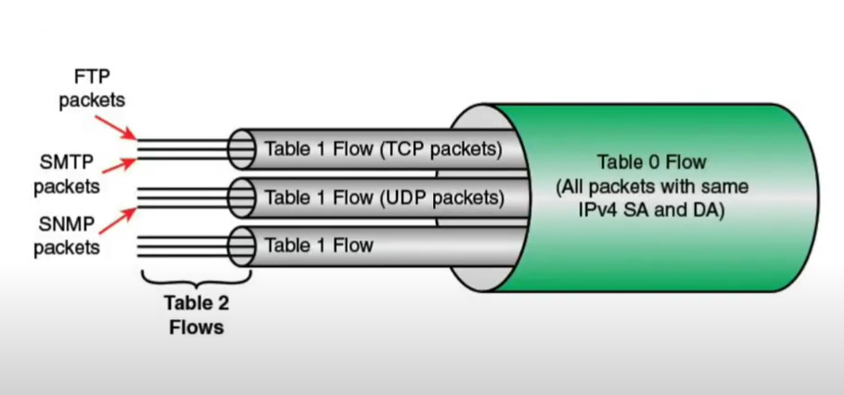
OpenFlow Switch – Use of multiple tables – Example of Nested Flows

Slide 25
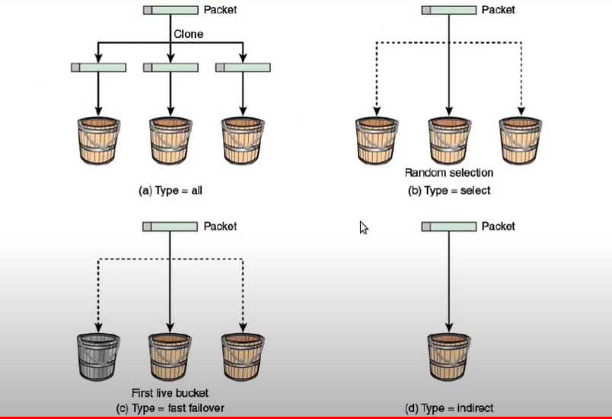
OpenFlow Switch – Group Tables

Slide 26
Overview of OpenFlow
OpenFlow defines both the communications protocol between the SDN data plane and the SDN control plane, as well as part of the behavior of the data plane.
General-purpose protocol for programming the forwarding plane of SDN switches.
Openflow.org in 2008 – Stanford University – (Experimental Version)
First version 1.0.0 in December, 2009 – (Development and Management)
Open Network Foundation (ONF) in March, 2011 – (Delivery)
OpenFlow remains at the core of their SDN.
ONF has become the responsible entity for the evolving OpenFlow specifications.

Slide 27
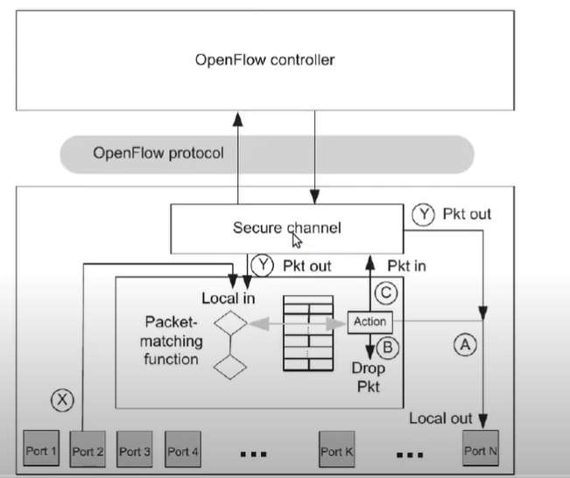
OpenFlow Switch – V.1.0

Slide 28
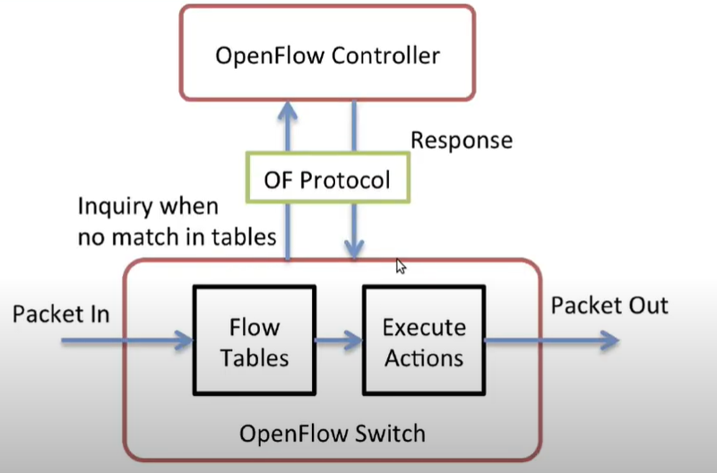
OpenFlow Controller
Defines the communication between an OpenFlow controller and an OpenFlow switch.

Slide 29
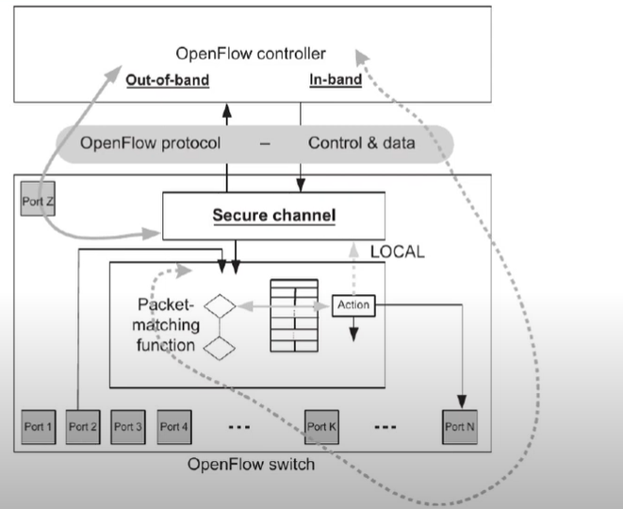
Controller-Switch secure channel

Slide 30
OpenFlow 1.0
Released on December 31, 2009.
Initial release of OpenFlow

Slide 31
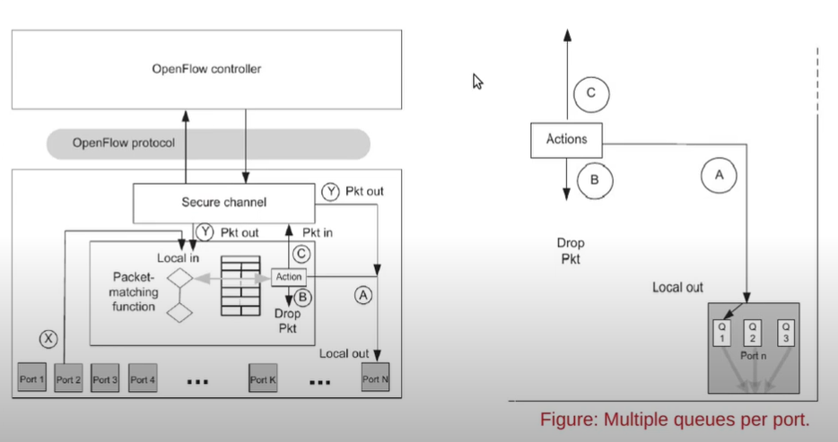
OpenFlow 1.0 – Ports and Port Queues

Slide 32
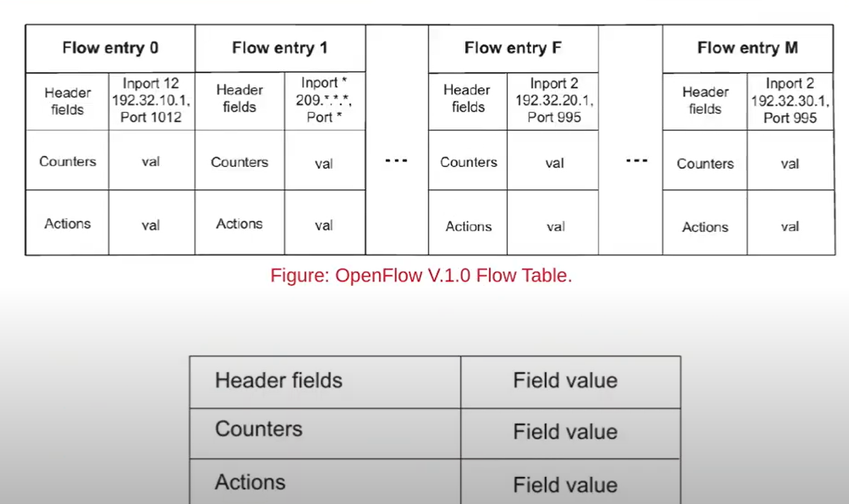
OpenFlow 1.0 – Flow Table
Basic flow entry

Slide 33
OpenFlow 1.0 – Packet Matching
When a packet arrives at the OpenFlow switch from an input port (or Controller), it is matched against the flow table to determine if there is a matching flow entry.
Some fields are:
Switch input port
VLAN ID
VLAN priority
Ethernet source address
Ethernet destination address
Ethernet frame type
IP source address
IP destination address
IP protocol

Slide 34
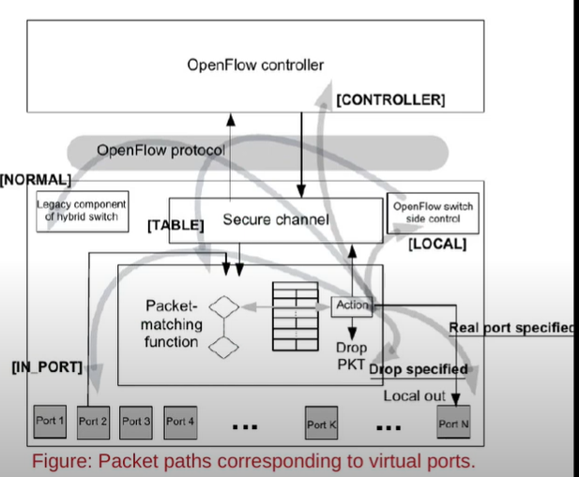
OpenFlow 1.0 – Actions and Packet Forwarding
Five special virtual ports defined in V.1.0
LOCAL
ALL
CONTROLLER
IN_PORT
TABLE
Two optional
NORMAL
FLOOD

Slide 35
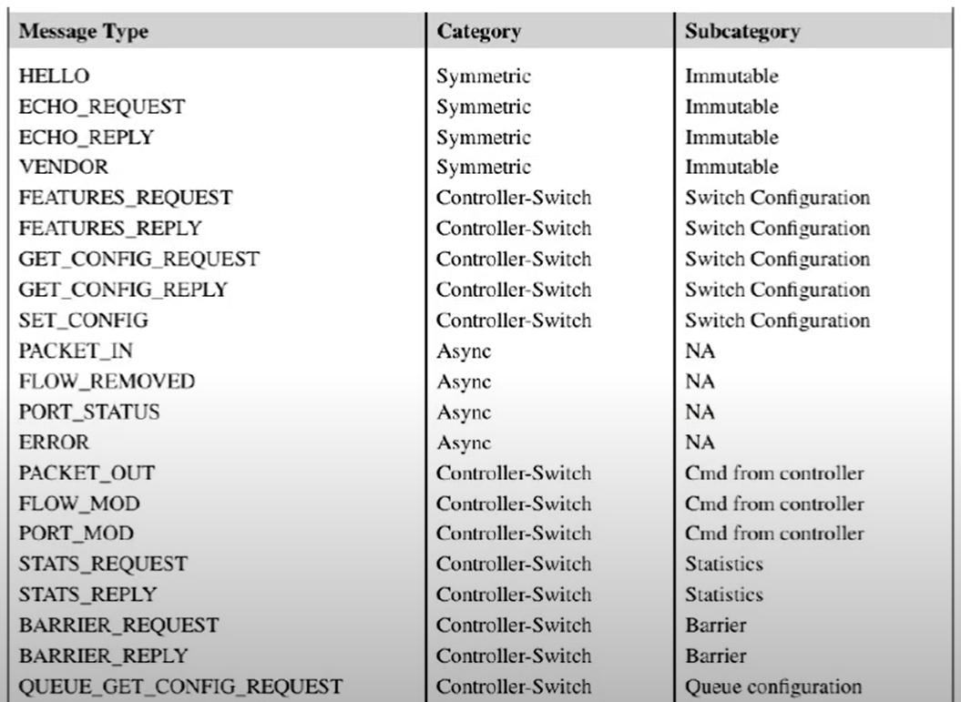
OpenFlow 1.0 – Messaging Between Controller and Switch

Slide 36
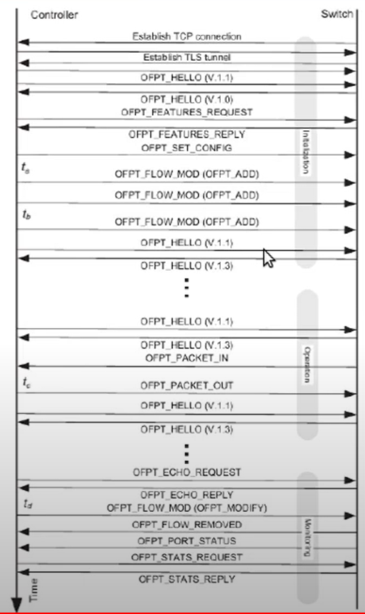
OpenFlow 1.0 – Messaging Between Controller and Switch

Slide 37
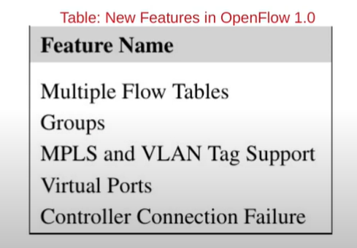
OpenFlow 1.1
Released on February 28, 2011.

Slide 38
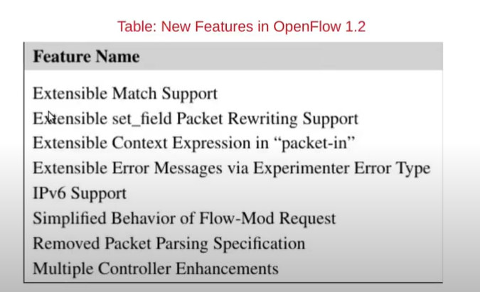
OpenFlow 1.2
Released on December 05, 2011.

Slide 39
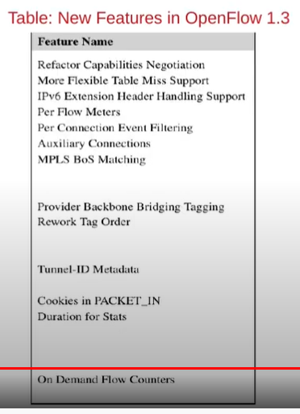
OpenFlow 1.3
Released on April 13, 2012.

Slide 40
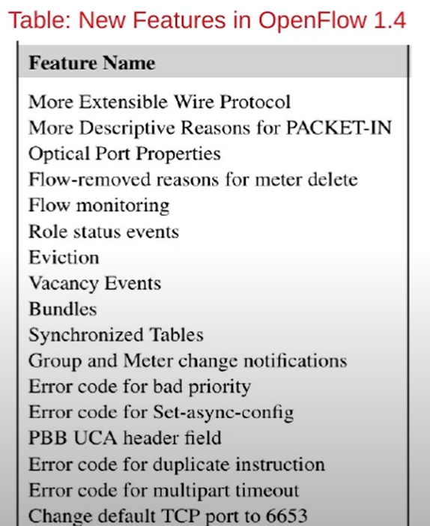
OpenFlow 1.4
Released on October 14, 2013

Slide 41
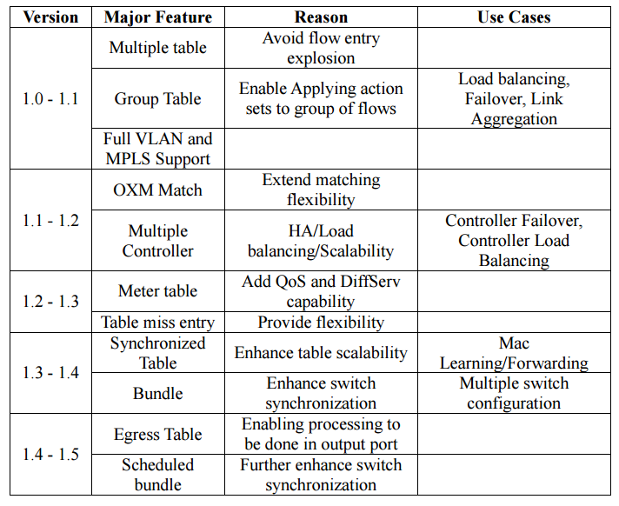
OpenFlow Version RoadMap
Feature-set comparison
MPLS – Multi-Protocol Label Switching
HA - High Availability

Slide 42
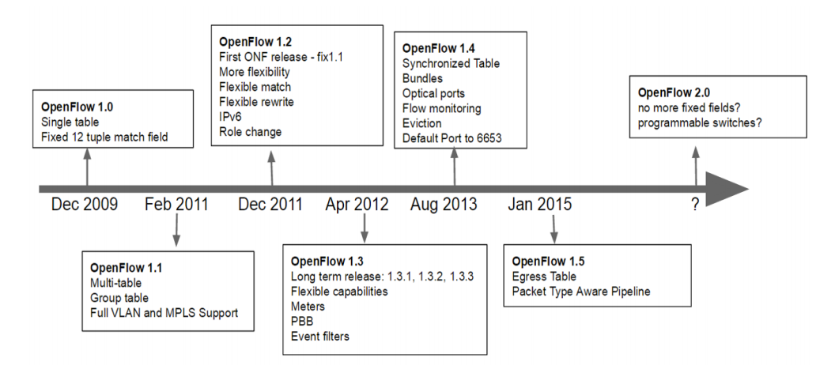
Timeline

Slide 43
Assignment questions
Explain OpenFlow architecture and list down OpenFlow components
What are Control Plane (CP) and Data Plane (DP) in SDN?
What are the central tasks of the Data Plane with the forwarding hardware?
What is data plane and what does it contain?
List down OpenFlow versions.
Explain OpenFlow components in detail.

Slide 44
Thankyou

